Slide 1

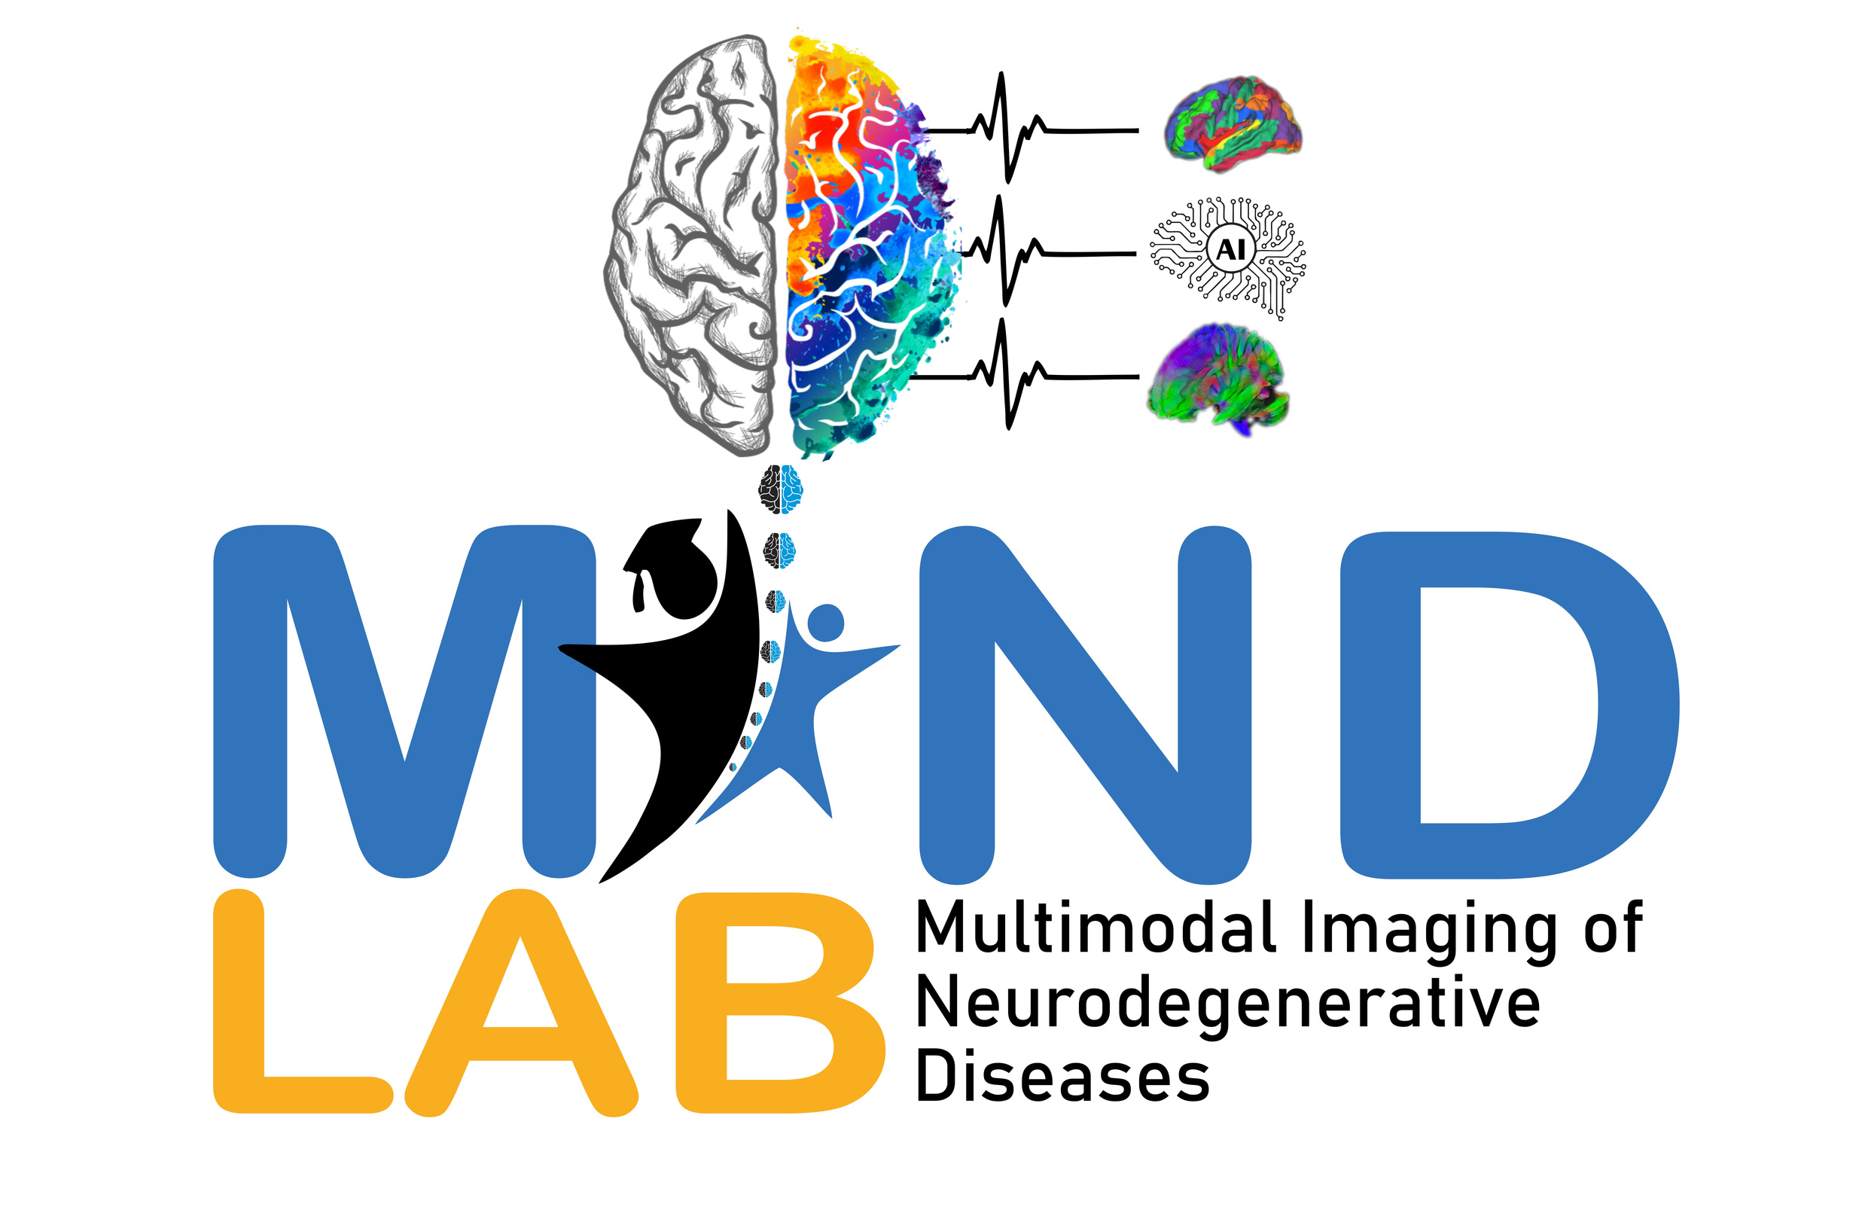



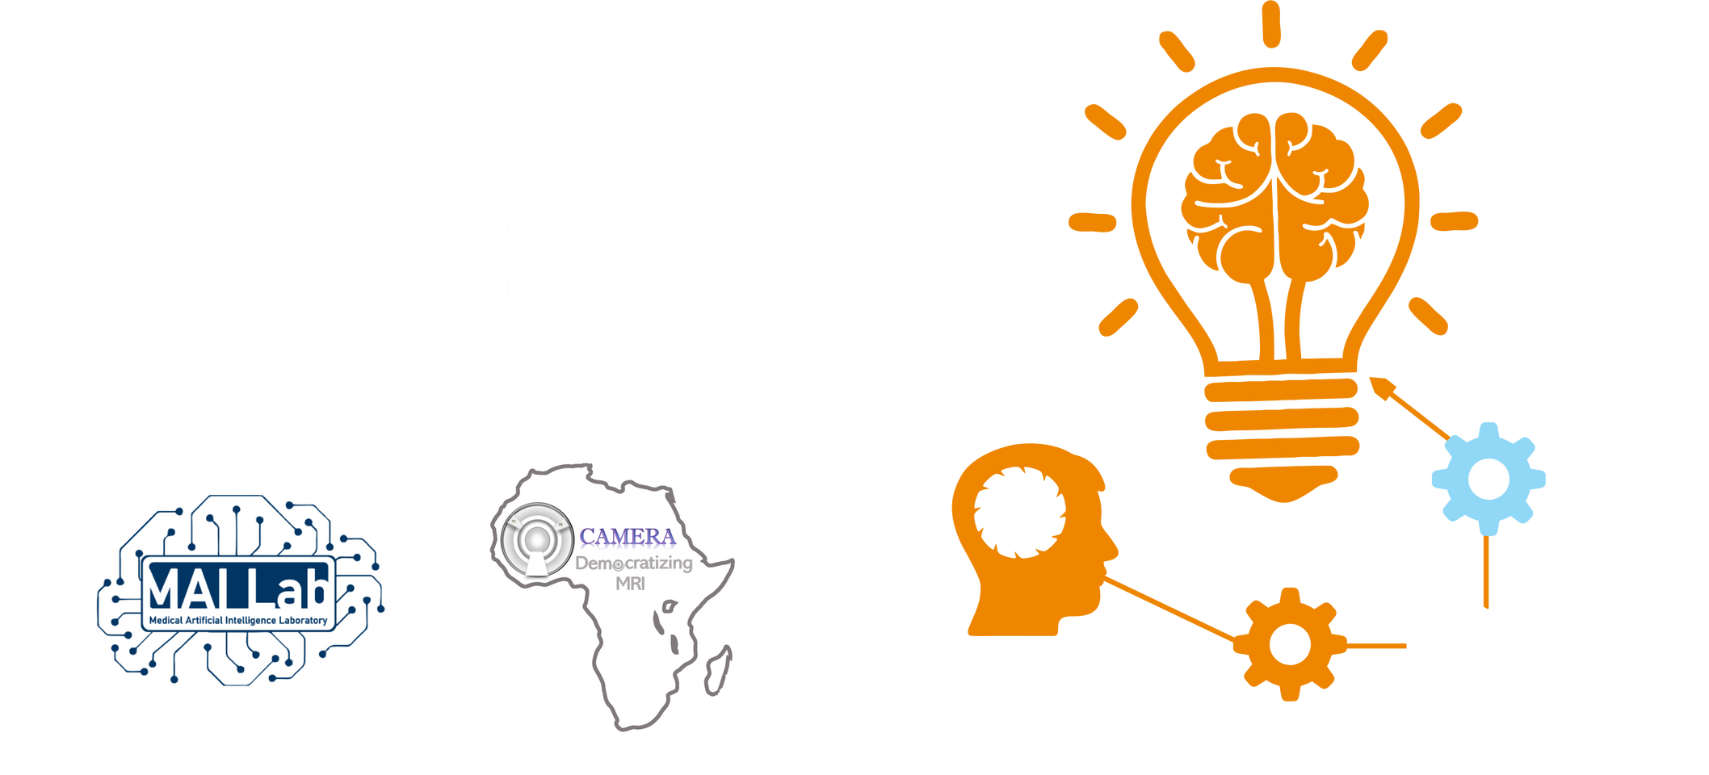
2025 SPARK ACADEMY
TRAIN FOR CHANGE, FROM SCIENCE TO PRACTICE
THE SPRINT AI TRAINING FOR AFRICAN MEDICAL
Imaging Knowledge Translation (SPARK)
Academy
IN DEEP LEARNING & MEDICAL IMAGING
What is AI?
March 15 2025

Slide 2
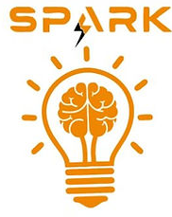
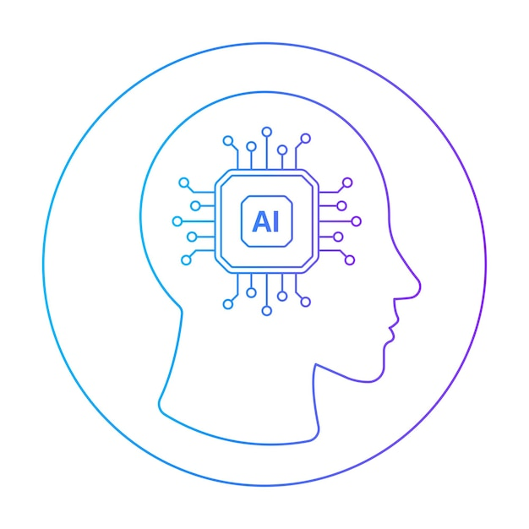
What is AI?
Sub-field of computer science. Artificial Intelligence (AI) studies how we can make the computer do things that humans can still do better at the moment.
https://www.freepik.com/vectors/artificial-intelligence-png

Slide 3
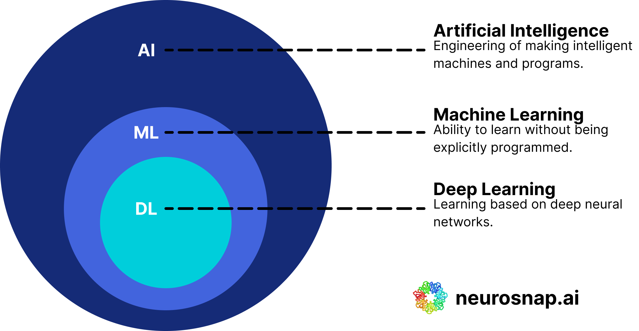
That sounds hard …. Let’s break it down
https://www.freepik.com/vectors/artificial-intelligence-png

Slide 4

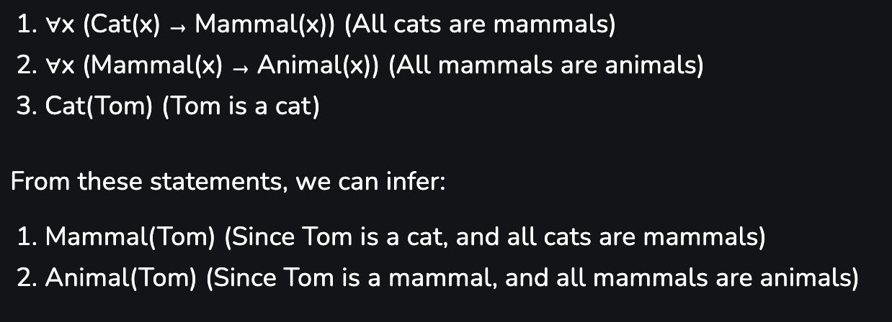
AI
When AI started it was about searching for a solution that answers the problem.
https://www.freepik.com/vectors/artificial-intelligence-png

Slide 5

ML/DL
ML tries to learn the pattern. In ML there are 3 main pillars
Supervised
Un-supervised
Reinforcement
https://www.freepik.com/vectors/artificial-intelligence-png

Slide 6
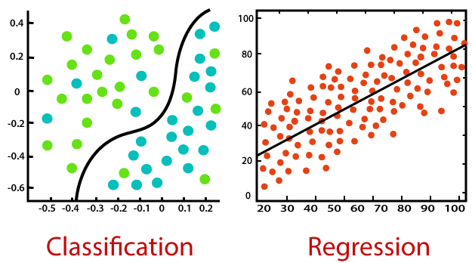
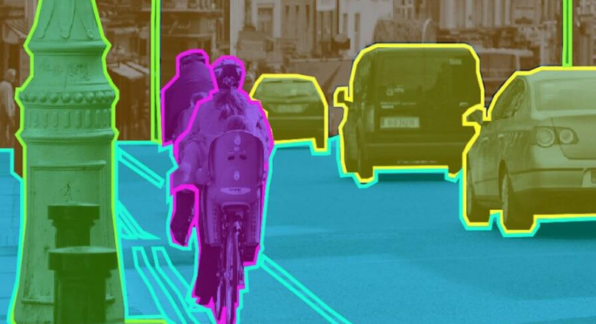
Supervised
Try to give the model A LOT of examples (input/output) and it learns from them.
classification
Regression
Segmentation

Slide 7
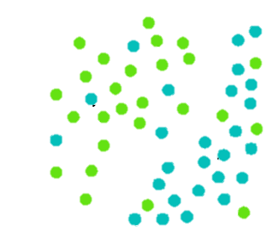
Supervised
Is it green or blue?
X-axis | Y-axis | label
0.4 | -0.4
0 | 0
-0.4 | 0.1
. . .
Object location
classification
Object location
Trained model

Slide 8
Supervised
What is the temperature?
Distance | temperature
40 | 30
100 | 100
50 | 55.3
. . .
Regression

Slide 9
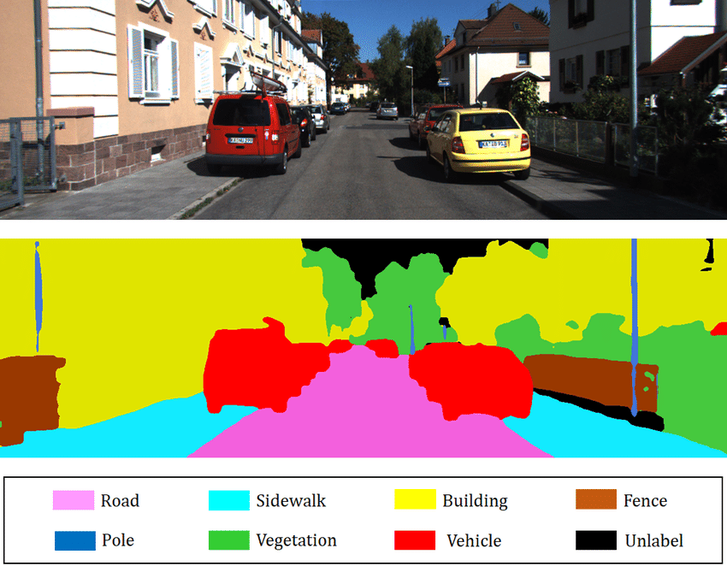
Supervised
Segmentation

Slide 10
Supervised
Segmentation + classification

Slide 11

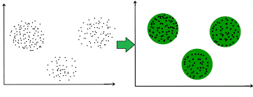
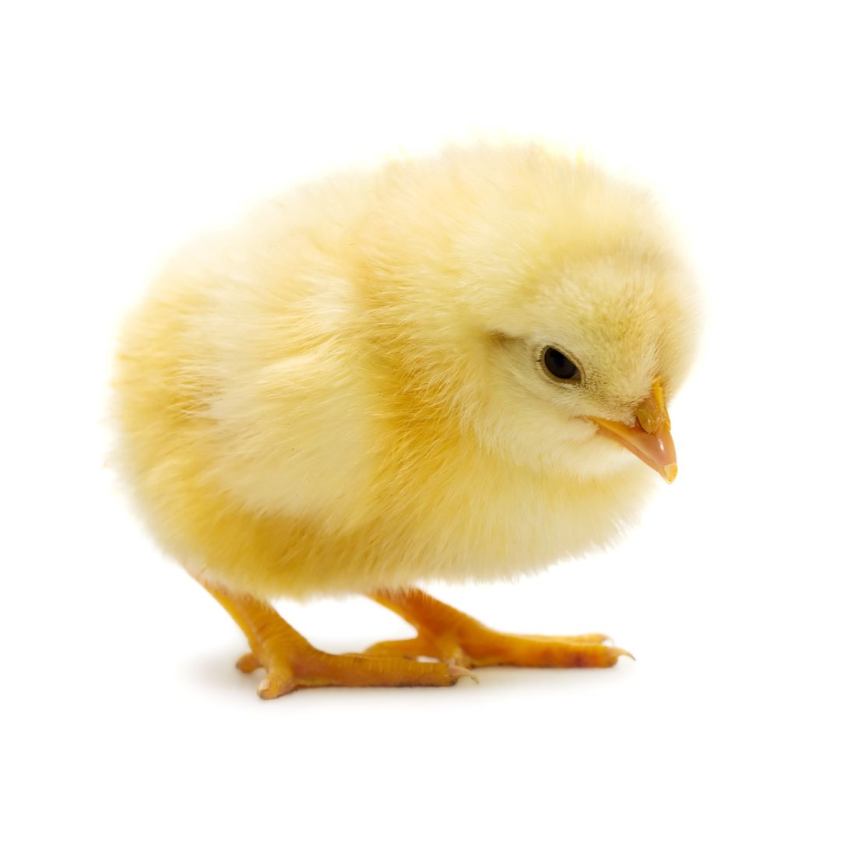
Un-supervised
Try to give the model A LOT of examples but without label and it learns from them.
Model
Embedding (meaning)
Clusters (meaning)

Slide 12
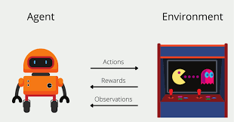
Reinforcement
The model plays in a simulation, it gets a reward for every good thing it makes and gets punishment for every bad thing
….. am like babies but 10000000x dumber

Slide 13
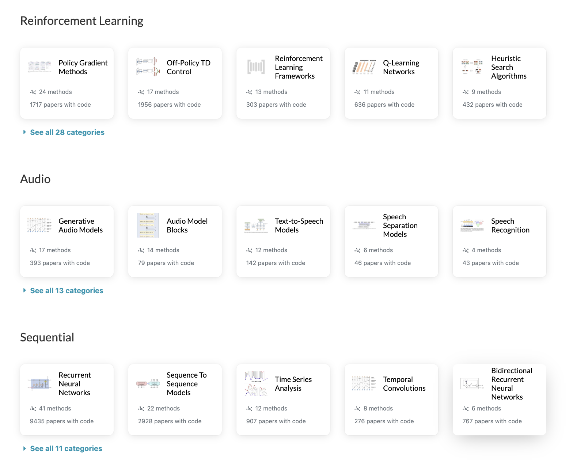
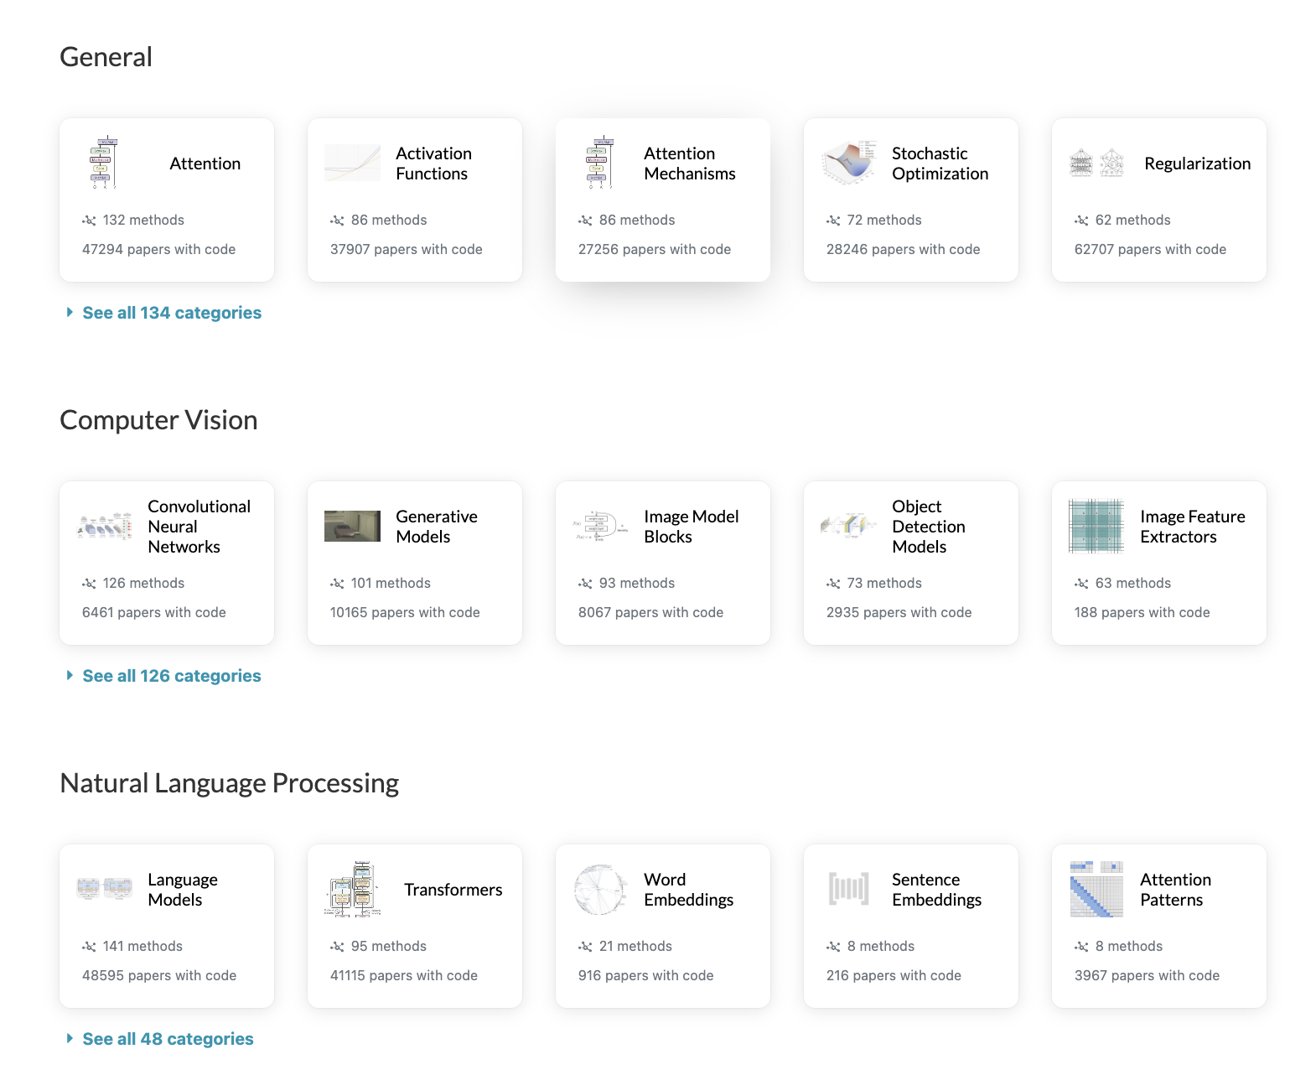
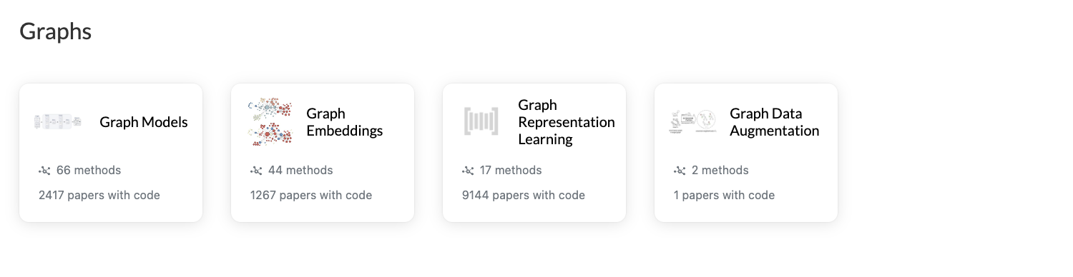
There are a lot more to learn

Slide 14
Want to be one of the best -> master the basics
do assignments, projects, particepate … hard work pays off

Slide 15
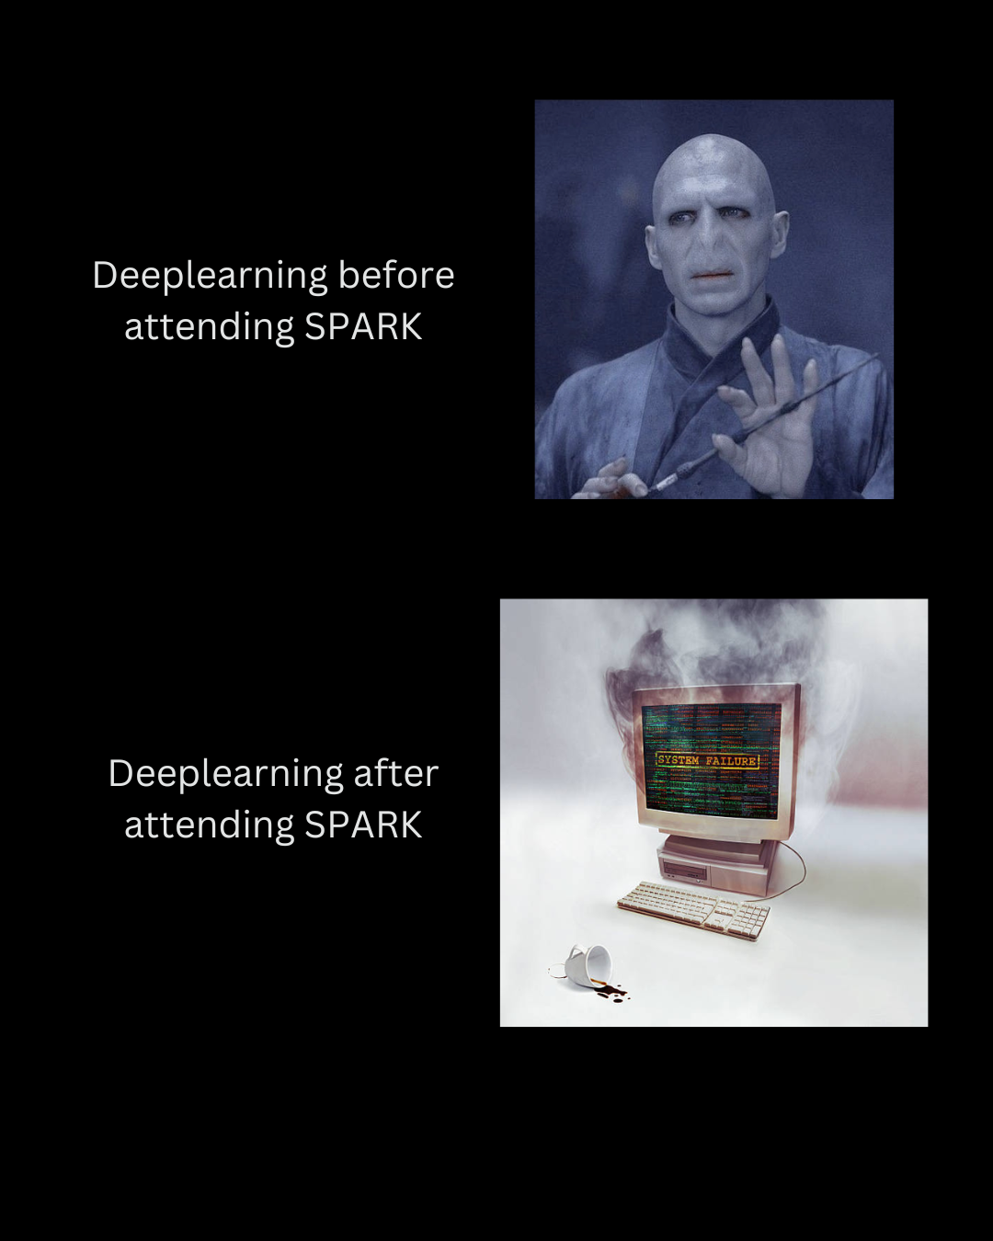

Thanks

